Slide 1
From Winter to Spring: Exploring the Evolution of AI Through Its Ups and Downs
A PRESENTATION FROM TOBIAS, LARA, AND TJORVEN

Slide 2
Contents
A brief introduction into AI
Menace
The 1st AI Winter
Expert Systems
The 2nd AI Winter
Neural Nets

Slide 3
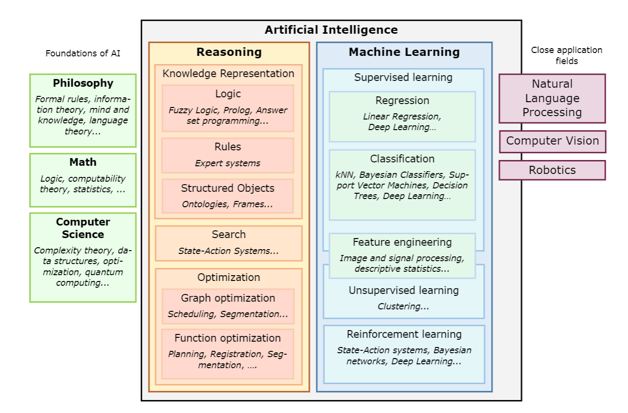
What About AI?
Definition of AI
Fields of AI
Alan Turing and the Turing Test
Logic Theorist – a way to prove mathematical theorems.
Rational vs Emotional and Thinking vs Acting

Slide 4
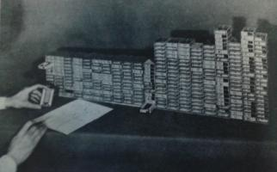
Menace
Matchbox Educable Noughts And Crosses Engine
AI Algorithm without a Computer
Represents States and Actions
Results in 304 matchboxes
Training happend with rewards and punishments
[1]

Slide 5
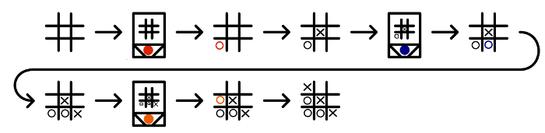
Menace - an Example
[2]

Slide 6
Menace - an Example
[2]

Slide 7
Menace - an Example
[2]

Slide 8
Menace - an Example
[2]

Slide 9
Menace - an Example
[2]

Slide 10
Menace - an Example
[2]

Slide 11
Menace - an Example
[2]

Slide 12
Menace - an Example
[2]

Slide 13
Menace - an Example
[2]

Slide 14
Menace - an Example
[2]

Slide 15
The First AI Winter
High and unmet Expectations
Technological Limitations
Funding Cuts
Criticism from the Scientific Community
Shift in Research Focus

Slide 16
Expert Systems

Slide 17
The Second AI Winter

Slide 18
Neural nets

Slide 19
SOURCES
Lecture Material of Prof. Dr. Mayer
https://www.mscroggs.co.uk/blog/19 [1, 2]

